Slide 1



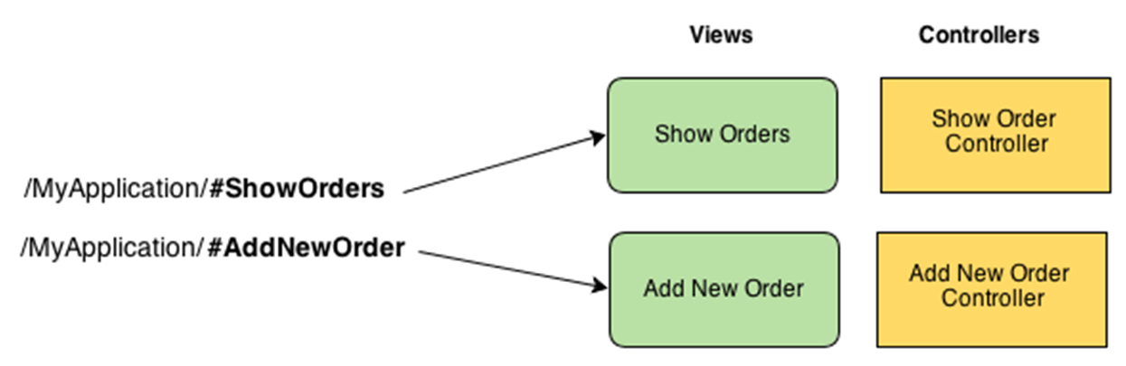
AngularJS Routing
Routes, Route Parameters, Templates, Location, Navigation
SoftUni Team
Technical Trainers
Software University
http://softuni.bg

Slide 2

Table of Contents
What is Routing in SPA?
What is Template?
Create and Navigate Routes
Working with Route Parameters
Enabling HTML5 Routing
Inspect URL Parts

Slide 3

What are Routing and Templates?
Routes and Templates in SPA

Slide 4
What is Routing in SPA?
Routing in SPA == mapping certain URL to certain page
E.g. #/user/orders → shows user's orders, #/login → shows the app login form
Provides history ([Back] and [Forward] browser buttons)
Descriptive URLs for the end user
Routing in Angular maps application paths to certain controllers + partial views (templates)

Slide 5
What is Template?
Templates == HTML fragments stored as .html files
E.g. a HTML template for listing customer orders in a table
Contain part of the web page (a partial view)
Usually bound to data stored in the $scope
Usually are rendered through AJAX
Rendered somewhere in the DOM
Typically in the <div ng-view /> element

Slide 6
Creating Routes in AngularJS
Routes, Templates and Controllers

Slide 7
Creating Routes in Angular
Create default page for your module (e.g. index.html)
Include all scripts (e.g. angular.js, angular-route.js, …)
Create <ng-view> directive inside your default page
Create a template (e.g. templates/news.html)
<header>
<a href="#/">Home</a>
<a href="#/news">News</a>
</header>
<ng-view>
// Here partial views will be rendered
</ng-view>

Slide 8
Creating Routes in Angular (2)
Include angular-route.js module
Add ngRoute dependency for your module
Add config and use $routeProvider to define your routes
var app = angular.module('app', ['ngRoute'])
.config(function($routeProvider) {
$routeProvider.when('/news', {
templateUrl: 'templates/news.html',
controller: 'NewsController'
});
$routeProvider.otherwise({ redirectTo: '/' });
});

Slide 9
Creating Routes in Angular
Live Demo

Slide 10
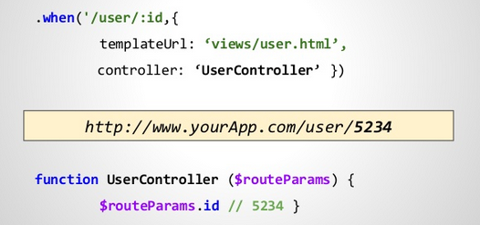
Working with Route Parameters

Slide 11
Working with Route Parameters
Pass news id as URL parameter
Add route for the page
Read the parameters through the $routeParams service
http://localhost:8080/#/news/4
$routeProvider.when('#/news/:newsId', {
templateUrl: 'templates/news-details.html',
controller: 'NewsDetailsController'
});
app.controller('NewsDetailsController', function($scope, $routeParams, newsData) {
$scope.news = newsData.getNewsById($routeParams.newsId);
});

Slide 12
Working with Route Parameters
Live Demo

Slide 13
Using the $route Service
URL:
params can access all parameters
pathParams only includes the parameters that are part of the route
reload reloads the page without reloading the entire application
http://localhost:8080/news/2?page=12
$route.current.params.newsId; // 2
$route.current.params.page; // 12
$route.current.pathParams.newsId; // 2
$route.current.pathParams.page; // undefined
$route.reload();

Slide 14
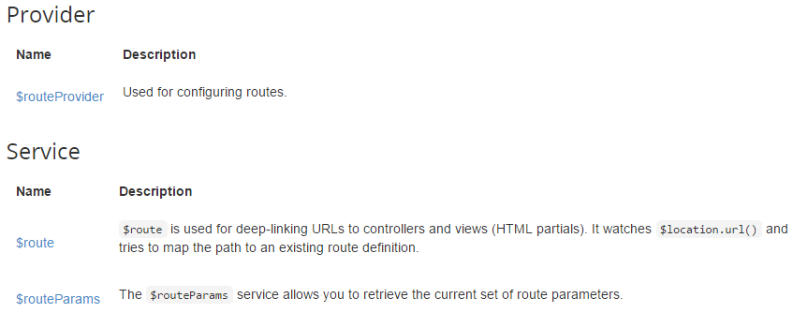
Using the $route Service
Live Demo

Slide 15
Enable HTML5 Routing
Inject $locationProvider in config function
Enable HTML5 Routing
Remove hashes (e.g. #) from menu links
You have HTML5 Routing
$locationProvider.html5Mode(true);
<a href="#/news">News</a>
<a href="news">News</a>
http://localhost:8080/news
http://localhost:8080/news/1

Slide 16
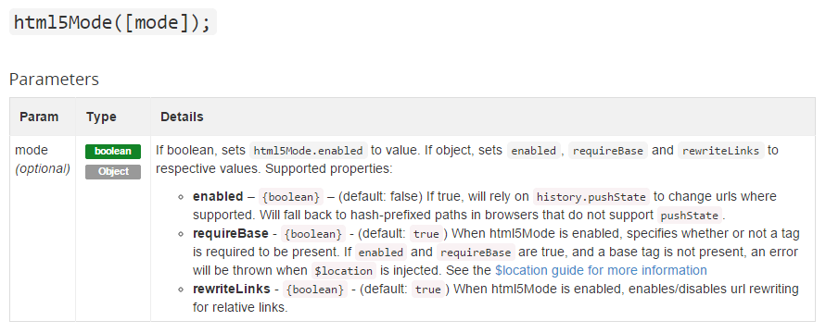
Enable HTML5 Routing
Live Demo

Slide 17
Inspecting URL Parts with $location
Using the $location service:
absUrl() → http://localhost:8080/news
protocol() → http
port() → 8080
host() → localhost
path() → /news
url() → /news
http://localhost:8080/news

Slide 18
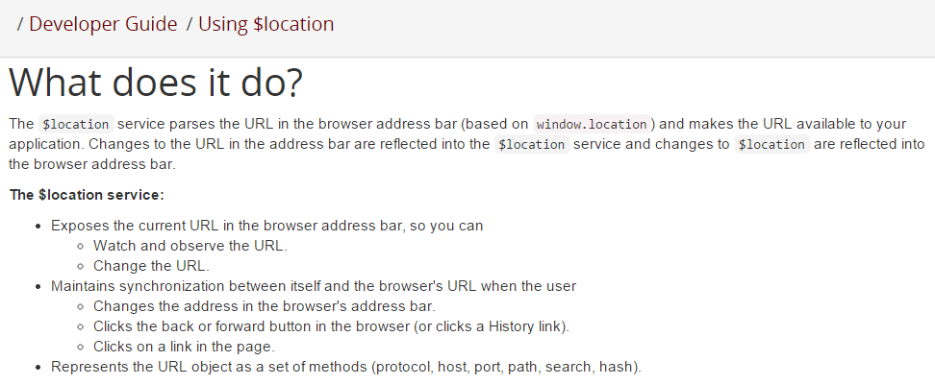
Using $location Service
Live Demo

Slide 19


Summary
Which service do you use to create routes?
$routeProvider
Which service do you use to access the route parameters?
$routeParams
How do you enable HTML5 routing?
$locationProvider.html5Mode(true);
SPA with AngularJS

Slide 20









AngularJS Routing
https://softuni.bg/courses/spa-applications-angularjs

Slide 21
License
This course (slides, examples, demos, videos, homework, etc.) is licensed under the "Creative Commons Attribution-NonCommercial-ShareAlike 4.0 International" license
Attribution: this work may contain portions from
"SPA with AngularJS" course by Telerik Academy under CC-BY-NC-SA license

Slide 22





Free Trainings @ Software University
Software University Foundation – softuni.org
Software University – High-Quality Education, Profession and Job for Software Developers
softuni.bg
Software University @ Facebook
facebook.com/SoftwareUniversity
Software University @ YouTube
youtube.com/SoftwareUniversity
Software University Forums – forum.softuni.bg

